Slide 1
Community Development Visualization
UCB Data Analytics Project 2
Niyati Desai | Guirlyn Olivar | Indrani Kompella
June 18 2018

Slide 2
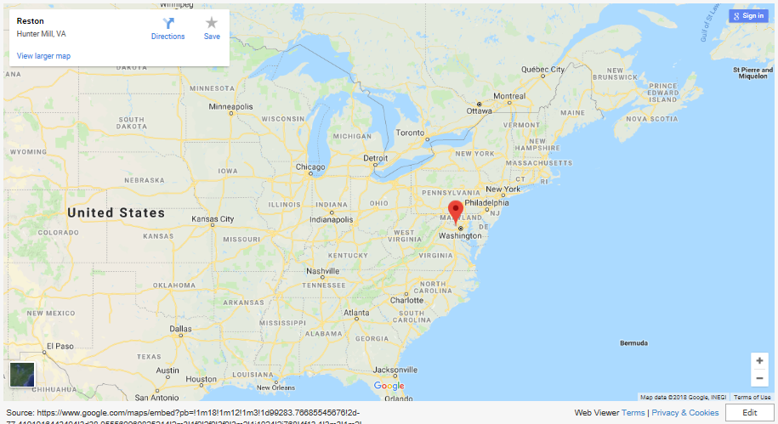

Slide 3
Theme
Reston,VA is a fast developing area within Fairfax County, VA. The impetus for the development in this area is the recent extension of Washington Metro.
A 2014 Planning Study has re-planned this area to transform this area to include a vibrant mix of uses, with the majority of future development focused near the station locations.
The master Plan created three new Transit Station Areas (TSA). Each TSA is further divided into Districts and Sub-Districts. The master Plan has guidance as to how specific areas within these TSA redevelop.

Slide 4
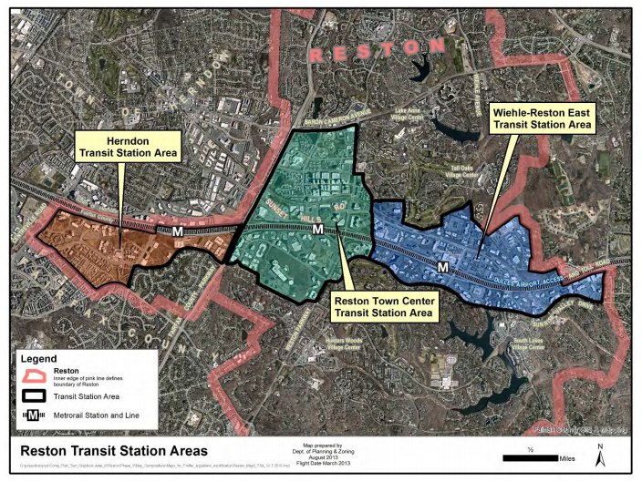

Slide 6
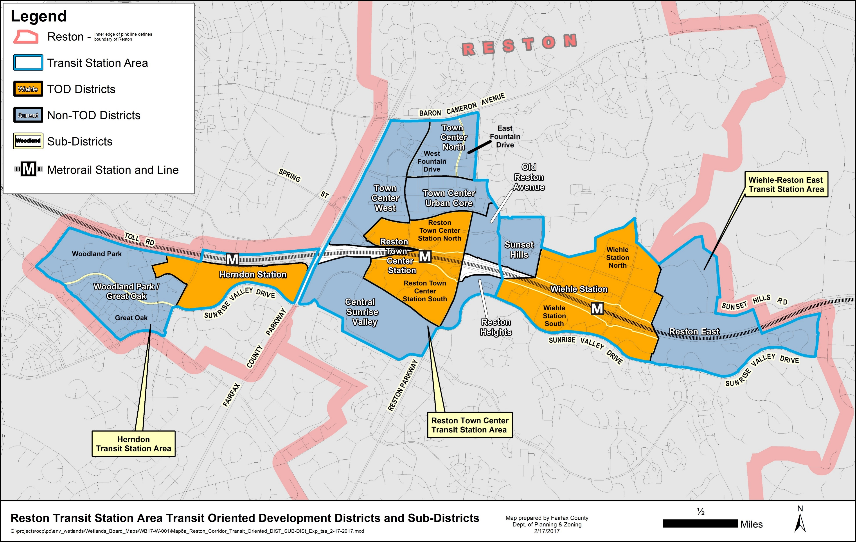

Slide 7
Analytics paradigm
This tool will help the County staff and citizens to monitor the current and future development potential/activity for any given area in the TSAs and analyze if the Plan's long-term goals are met.
In addition, this tool will let the users to engage in scenario building activity to understand the impacts of specific development plans.

Slide 8
Coding approach
Full stack web application for a dashboard page with multiple charts
Github (https://github.com/indranik/Project2) repository from day one
Proposal in README.md
Use of git Issues to define and assign tasks
Use of git branches to merge updates via pull requests and approvals
Additional library not used in class:
JS slider package: jqwidgets (https://www.jqwidgets.com/), jqxchart
Menu styling and title animation: Animate.css (https://daneden.github.io/animate.css/)
Leaflet.shapefile and Leaflet.groupedLayers

Slide 9
Data munging techniques
Dataset includes:
Fairfax County's Tax Records and Plan Buildout and development pipeline data in csv,shapefile and sqlite db formats
Flask app:
JavaScript logic for DOM elements manipulation
Use of d3/svg for graphics controls
Use of POST/GET methods for data transfer: from user selection to logic for data filtering and calculations and data display.
SQLite database for data manipulation
Use of SQLAlchemy for creating session to retrieve data
Use of db functions like sum to process over the data.
Pandas for shaping data to the Web
Final data manipulation for Web display of user selections

Slide 10
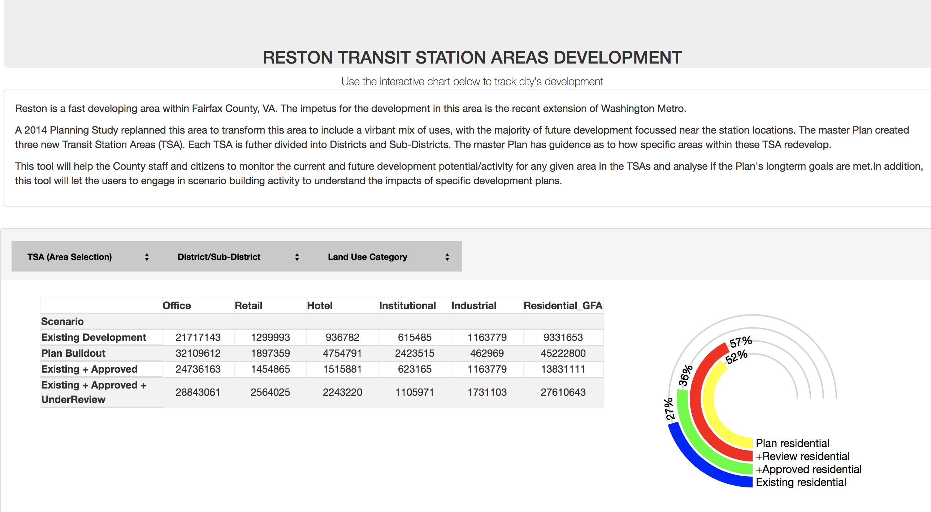
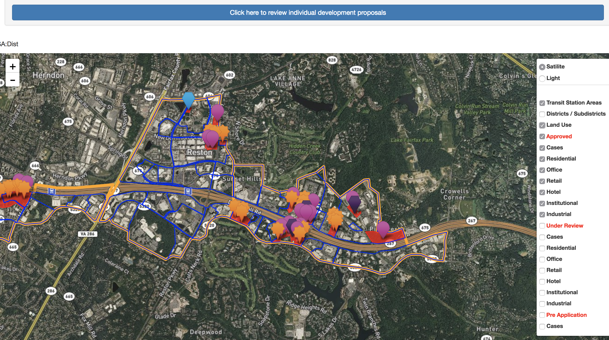
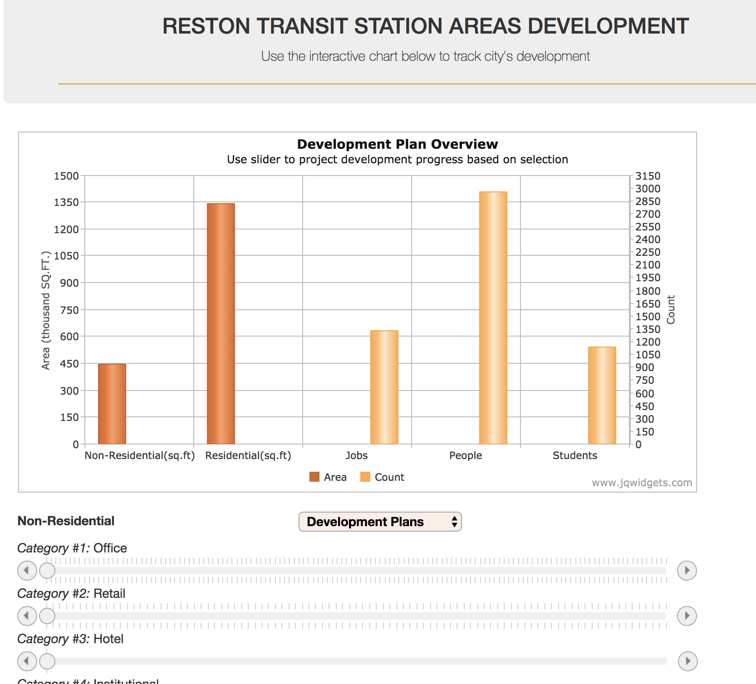
Final Visualizations
User input components:
Dropdown list selection
Map layers
Slider
Visualizations
Table summary data
Gauge
Map pins
Bar plots

